Slide 1

Relational Databases
Data modeling
Types and stages of Data Model
Originally prepared by Jennifer Widom

Slide 2
Database Design
Process of creating a design for a database that will support the enterprise’s mission statement and mission objectives for the required database system.

Slide 3
Database Design
Main purposes of data modeling include:
to assist in understanding the meaning (semantics) of the data;
to facilitate communication about the information requirements.
Building data model requires answering questions about entities, relationships, and attributes.

Slide 4
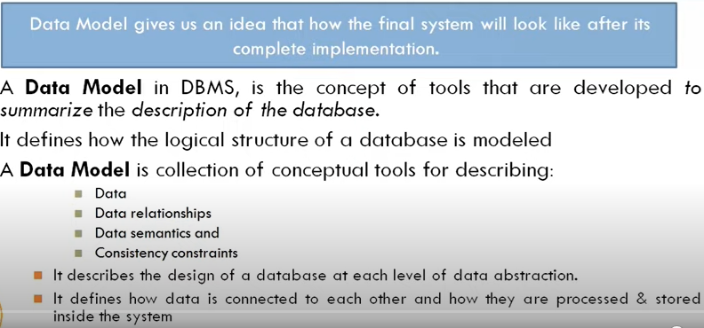
Data-Model

Slide 5
Types of DATA - MODEL
Relational
Hierarchical
Network model
E-R model

Slide 6
Database Design
A data model ensures we understand:
- each user’s perspective of the data;
-nature of the data itself, independent of its physical representations;
- use of data across user views.

Slide 7
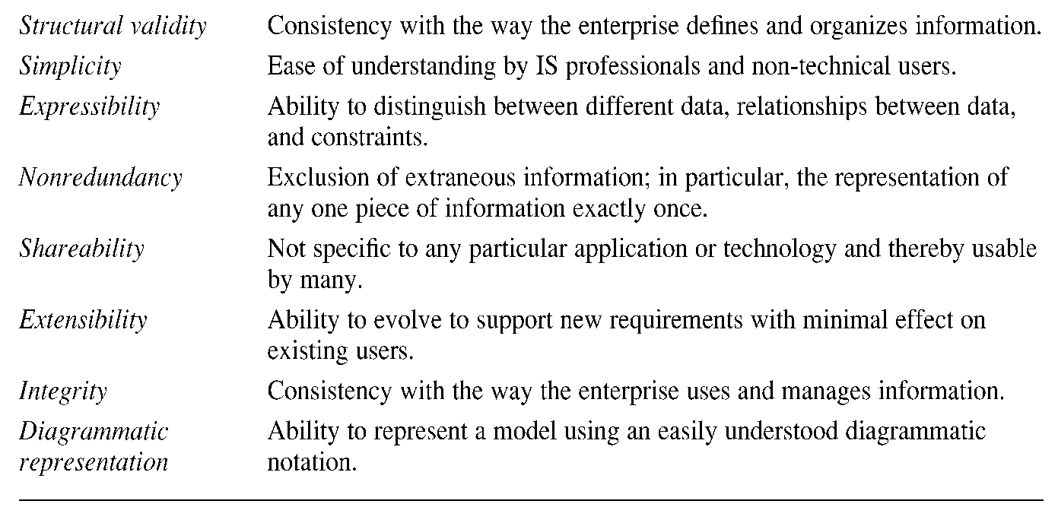
Criteria to Produce an Optimal Data Model

Slide 8
Stages of Data -MODEL
Conceptual data Model
Logical data Model
Physical data Model
Notes:
When data-model is being designed we progress through three main stages .so lets look at a ist stage which is conceptual data model .

Slide 9
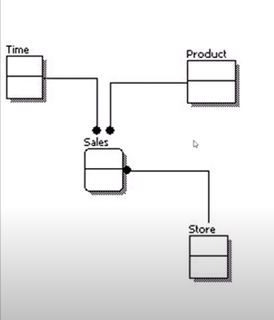
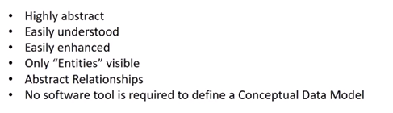
Conceptual Data Model
Notes:
Set of square shapes connected by lines .square shapes are entities and lines represent relationships .

Slide 10
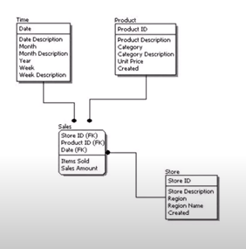
Logical data Model
Notes:
It expands the conceptual data model

Slide 11
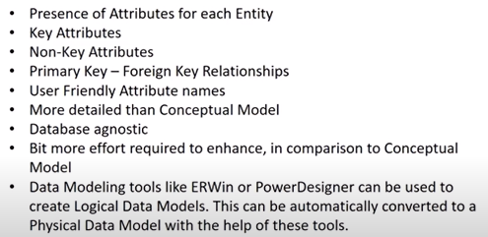
Logical Data Model

Slide 12
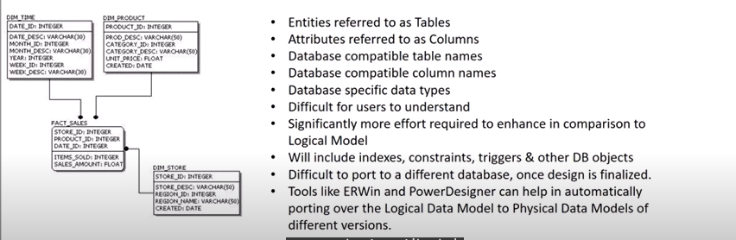
Physical Data model

Slide 13
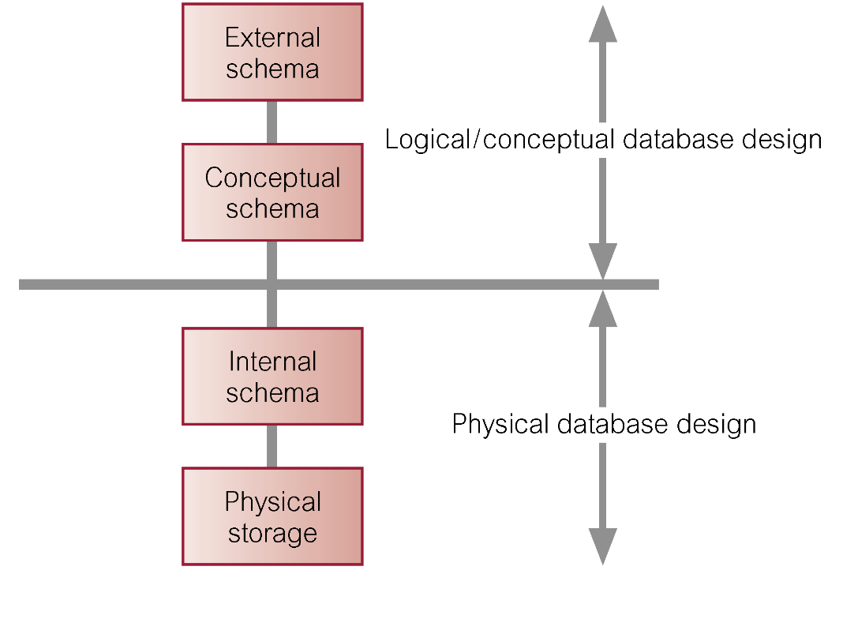
Three-Level ANSI-SPARC Architecture and Phases of Database Design

Slide 14
Introduction To E-R model
Chapter 12

Slide 15
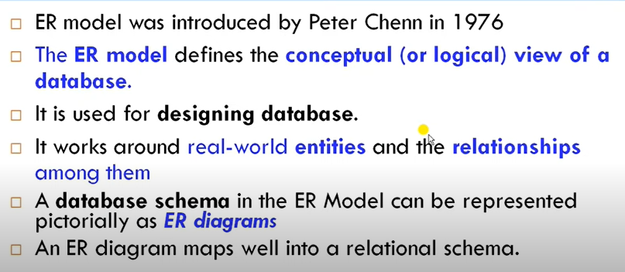
ER-Model

Slide 16
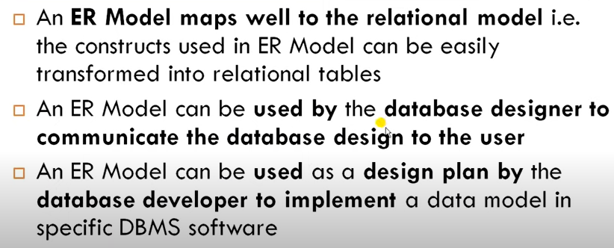
Why ER-Model is useful

Slide 17
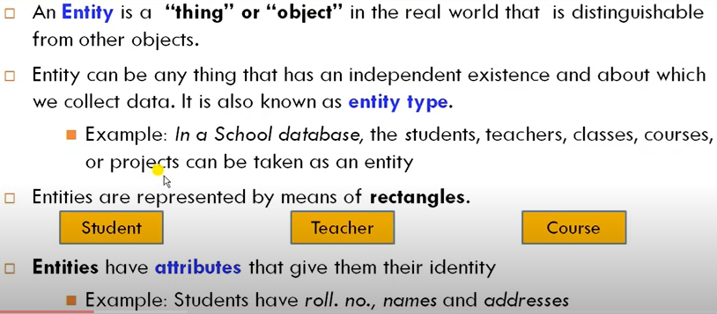
Entity

Slide 18
Example
name
manf
Entity set has two attributes, name and manf (manufacturer).
Each cold drinks entity has values for these two attributes, e.g. (coke , Anheuser-Busch)
Coldrinks

Slide 19
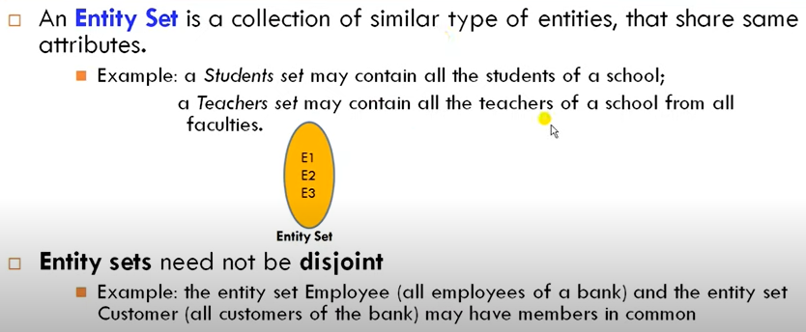
Entity Set

Slide 20
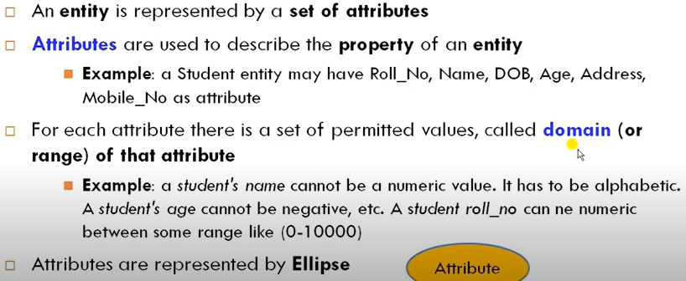
Attributes

Slide 21
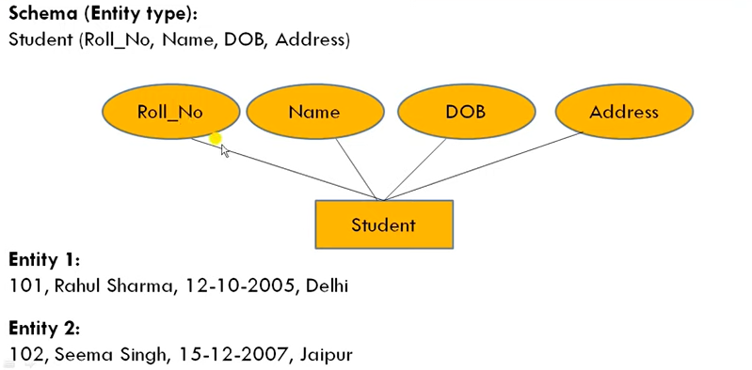
Entity type

Slide 22
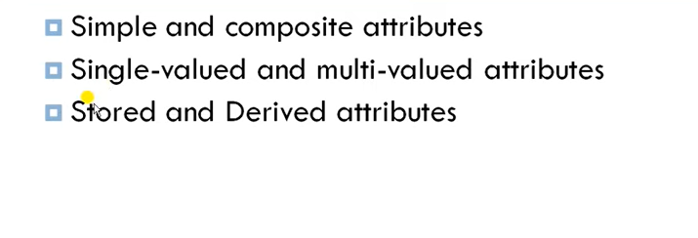
Types of Attributes
Key and non key attributes
Notes:
Simple that cannot be further divide
Age
Composed of more then 1 value
Name
Single---registration no
Multi valued ________ phone no double eclips
Stored –fixed ___ dob
Derived ____ age ----- denoted by doted eclips

Slide 23
Keys
A key is a set of attributes for one entity set such that no two entities in this set agree on all the attributes of the key.
It is allowed for two entities to agree on some, but not all, of the key attributes.
We must designate a key for every entity set.

Slide 24
Example: a Multi-attribute Key
dept
number
hours
room
Courses
Note that hours and room could also serve as a
key, but we must select only one key.

Slide 25
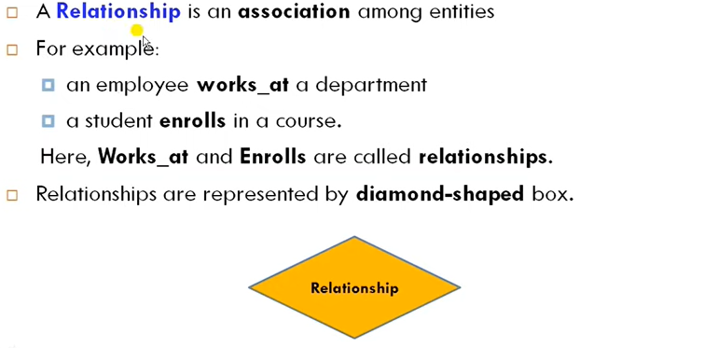
Relationship

Slide 26
Example
name
addr
name
manf
Stores
Sells
Cold drinks
Stores sell some
Cold drinks
license
Customers like
some cold drinks .
Frequents
Likes
Customers frequent
some stores .
Drinkers
name
addr

Slide 27
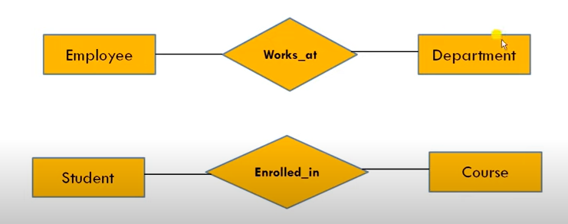
Example

Slide 28
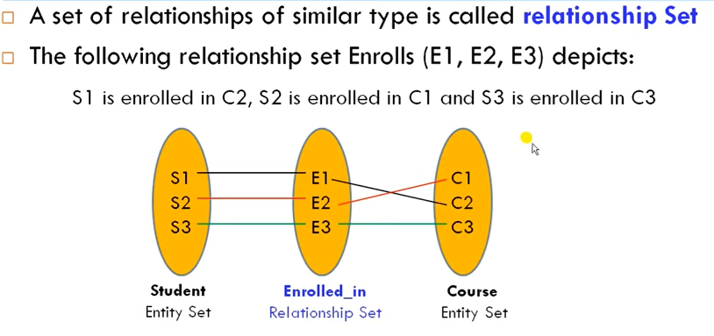
Relationship Set

Slide 29
Attributes on Relationships
Sometimes it is useful to attach an attribute to a relationship.
Think of this attribute as a property of tuples in the relationship set.

Slide 30
Example
Sells
Stores
Cold drinks
price
Price is a function of both the Cold drinks and stores ,
not of one alone.

Slide 31
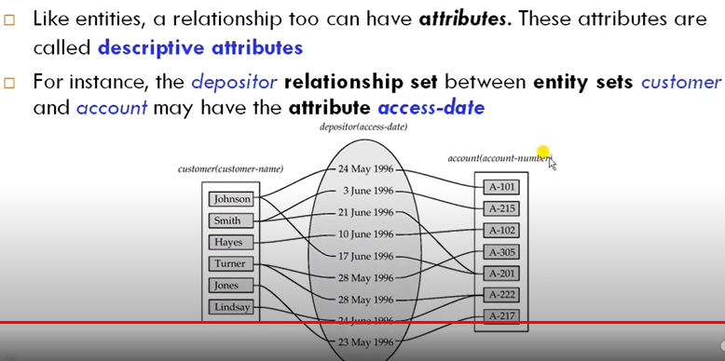
Descriptive attribute

Slide 32
Example
For the relationship Sells, we might have a relationship set like:
Bar Beer
Joe’s Bar Bud
Joe’s Bar Miller
Sue’s Bar Bud
Sue’s Bar Pete’s Ale
Sue’s Bar Bud Lite

Slide 33
Equivalent Diagrams Without Attributes on Relationships
Create an entity set representing values of the attribute.
Make that entity set participate in the relationship.

Slide 34
Example
Sells
Stores
Cold drinks
Prices
Note convention: arrow
from multiway relationship
= “all other entity sets
together determine a
unique one of these.”
price

Slide 35
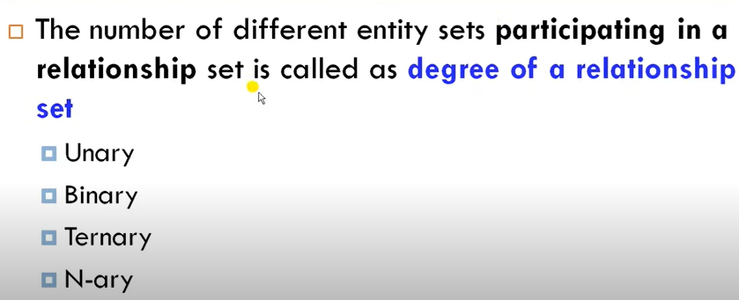
Degree of Relationship

Slide 36
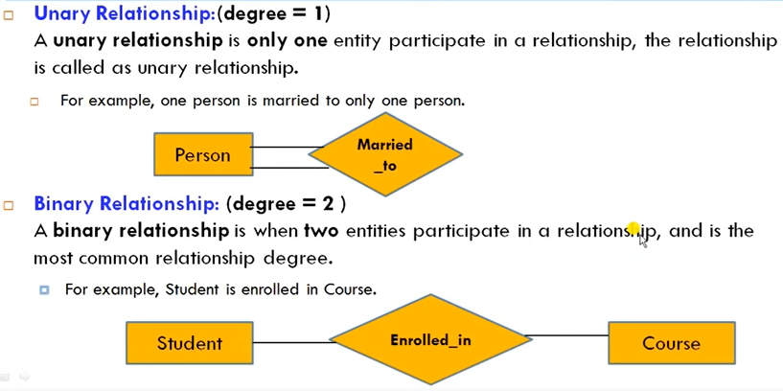
Degree of Relationship

Slide 37
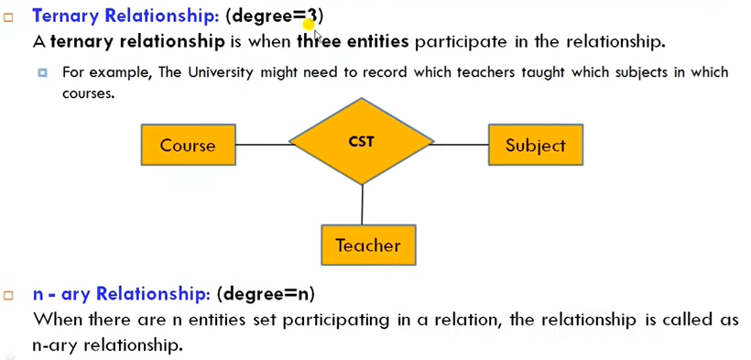
Degree of Relationship

Slide 38
Lab activities
IN operator
Like operator
Between
Escape Identifier
0rder by
Single and double ampersand

Slide 39
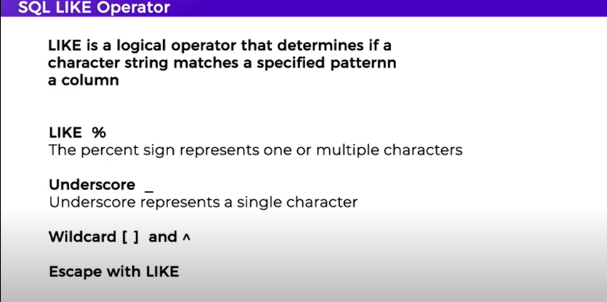
Like operator

Slide 40
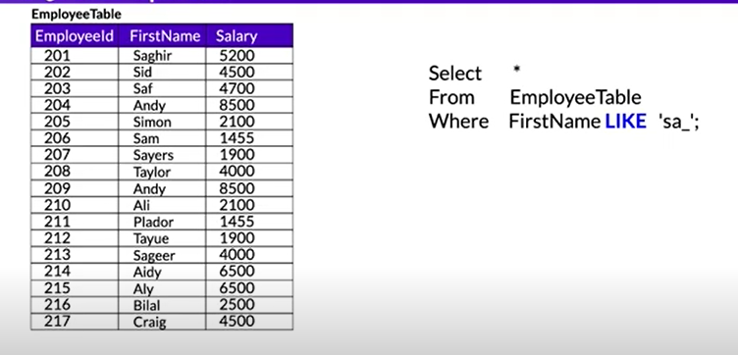
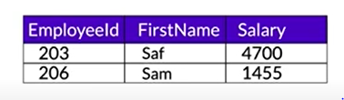
Like operator with _

Slide 41
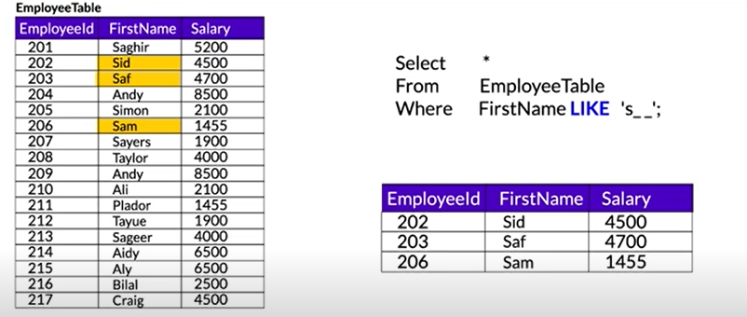
Like operator with _

Slide 42
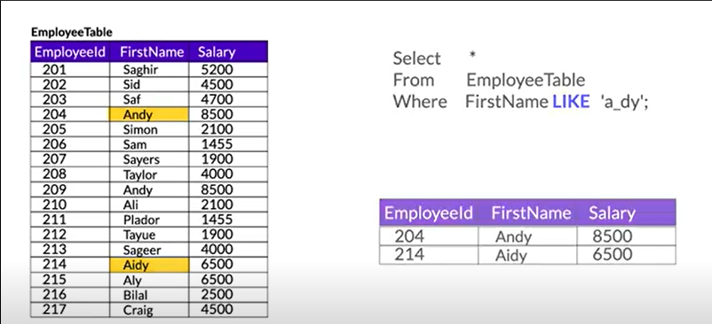
Like operator with _

Slide 43
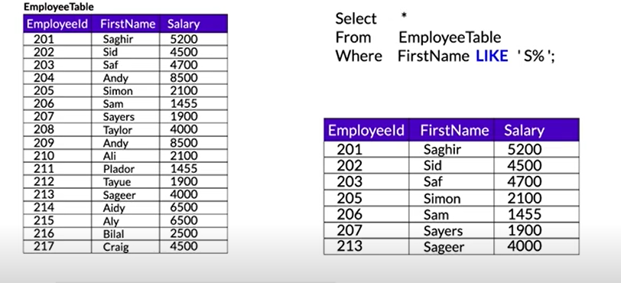
Like operator with %

Slide 44
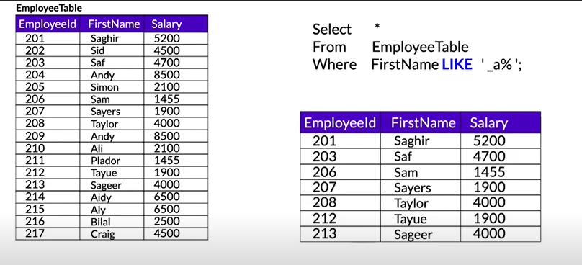
Like operator with % and _

Slide 45
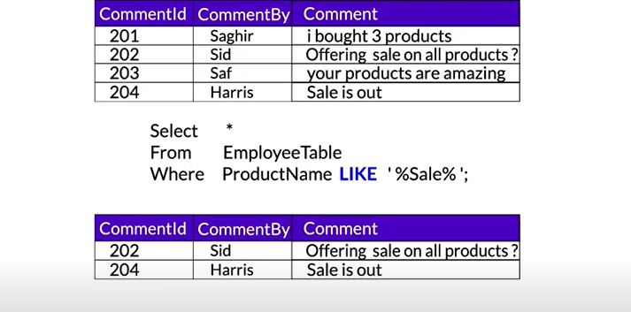
Like operators with %

Slide 46
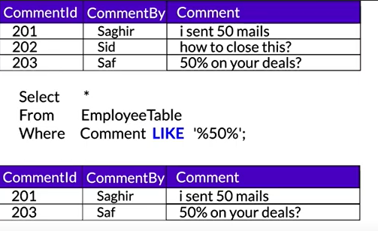
Like operators with %

Slide 47
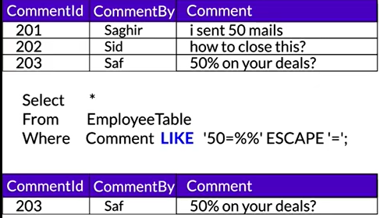
Escape character

Slide 48
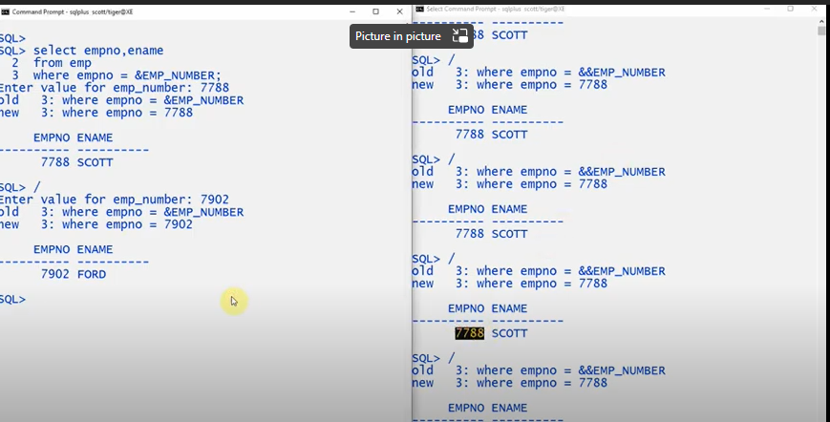
& vs &&

